Slide 1
Dental Foundation Recruitment 2020/2021

Slide 2
Dental Foundation Training (DFT)
DFT is a year’s employment and training generally within NHS General or Personal Dental Services and satisfactory completion allows unsupervised entry to the NHS Performers List in England and Wales and Health Boards in Scotland and Northern Ireland
The recruitment process is a competitive assessment for a job

Slide 3
Satisfactory Completion of DFT
You will be required to demonstrate satisfactory completion of the Dental Foundation Training programme in order to be awarded a Certificate of Satisfactory Completion
You will be expected to complete both a minimum 12 months of full-time training and demonstrate satisfactory progress
Your progress will be formally assessed by a panel after 5 and 10/11 months; this will be done by reviewing reports from your Educational Supervisor(s) and Training Programme Director, together with evidence from your assessments and your e-Portfolio
You will be required to have demonstrated a broad range of the competencies set out in the DFT Curriculum and your training could exceptionally be extended beyond a year if the panel decides that this is necessary
Please note, the delivery of the competencies required may be impacted due to Covid-19 on dentistry and Dental Foundation Training and the timelines above may be subject to change.
Assessment of Satisfactory Completion is not an examination
You will have the right to appeal a Final panel’s recommendation if you think its decision is not correct.

Slide 4
Overview of the 2020/21 Recruitment Process
Number of posts and applications
Recruitment process
Supporting candidates with a Disability
Special Circumstances
Which training posts are included
Key dates for 2020/21
How to apply
How will I be assessed
Selection Method for 2020/21
Preferencing of schemes
Offers and allocations to schemes
Quality Assurance
Key Information
Reminder of key dates
Questions

Slide 5
Number of Posts and Applications – 2019/20
Number of applications: 1110
Number interviewed: 1072
Number of places offered and accepted in June 2020: tbc
Number of DFT places currently available in England, Wales and Northern Ireland: 905 (as of June 2020)

Slide 6
Recruitment Process
The aim is to rank eligible applicants and allocate to 1 year DFT and Longitudinal (2 year) schemes
Due to the ongoing pandemic, the Dental Foundation Training National Recruitment Office has been required to adapt the way we select Foundation Dentists in 2020/21
Ranking will be based on the Situational Judgement Test score alone for 2020/21 as a covid-19 contingency measure. There will be no face to face interview process in 2020/21
Popular schemes are likely to be more competitive (more applicants per place)
Process complies with employment law requirements

Slide 7
Rationale for Implementing the COVID-19 Contingency Measures
Wherever possible, Health Education England will not hold face to face interviews in 2020 to protect those involved in the appointment process
Online interviews can be unreliable due to poor connectivity resulting inconsistent applicant experience
Assessor availability may be restricted in view of the pressures on dental practices
The SJT already comprises of 50% of the final score and includes significant aspects of the face to face elements
An Equality Impact Assessment will be conducted in connection with the changes
HEE has discussed the changes with the BDA who have understood the need for contingency measures for this year only
Applicants will be surveyed on their experience of the contingency measures to inform future planning discussions

Slide 8
Supporting candidates with a disability – Declare at time of application
Applicants are encouraged to declare any disability on the application form, to ensure they are supported through the process. They will also be required to fill out the form via https://lasepgmdesupport.hee.nhs.uk/support/tickets/new?form_15=true and provide evidence. Full guidance will be given when the advert is published on Oriel
A disability can not be considered retrospectively. The absolute deadline for this is 10 September 2020 (Application close date), after which point no adjustments will be made
Allowances and adjustments will be made in accordance with Health Education England policies

Slide 9
Special Circumstances
This applies to applicants with special circumstances who have a requirement to train in a particular location. Eligibility Criteria:
Criterion 1 – applicant is the primary carer for someone who is disabled as defined by the Equality Act 2010
Criterion 2 – applicant has a medical condition or disability for which ongoing follow up for the condition in the specified location is an absolute requirement
Criterion 3 – Parental Responsibilities – applicant is the parent of a child under the age of 18
Apply on application and submit supporting evidence directly to London & Kent, Surrey and Sussex Recruitment
All applications for Special Circumstances, where appropriate evidence is provided, will be considered but acceptance will be subject to availability and cannot be guaranteed
Where approved, allocations will be to a Scheme, not a training practice
More details available in the Application Handbook and applicants for Special Circumstances consideration will subsequently be contacted by London & KSS Recruitment

Slide 10
Which training posts are included?
All Dental Foundation posts in England, Wales & Northern Ireland starting in September 2021.
Please note appointment of training practices and Educational Supervisors for 2021/22 is not confirmed until 2021 therefore any location information given on websites is for guidance only
Practices have clinical commitments and it is not recommended that you visit any practice before you have been offered a training place
Scotland will recruit separately to its schemes.

Slide 11
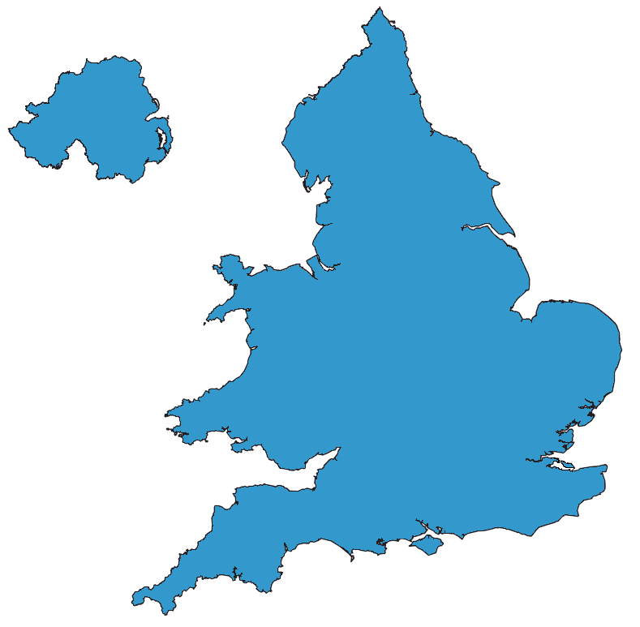
England, Wales and Northern Ireland - Health Education England Areas and Deaneries
North West
Midlands & East
South West
Thames Valley & Wessex
London and Kent, Surrey & Sussex
North East
Yorkshire and Humber
Wales
Northern Ireland

Slide 12
Key dates for 2021 Schemes
Applications Open 13 August 2020
Applications Close 10 September 2020
Online Situational Judgement Test (SJT) 2 – 10 November 2020
(dates subject to variation to accommodate home tests)
Assessment Centres No assessment centres in 2020 due to covid-19
Preferencing of Schemes 12 December 2020 – 13 May 2021
Initial Offers 10 June 2021

Slide 13
How to apply?
Advert, application form, person specification and applicant guide will be available on the Oriel website from 12:00 on 13 August 2020 until 09:00 on 10 September 2020 only:
https://new.oriel.nhs.uk/Web
All communications from the DFT National Recruitment Office will be sent via Oriel

Slide 14
Oriel has changed!
Oriel 2 has launched and can be accessed from this link: https://new.oriel.nhs.uk/Web
Oriel 2 works in the same way as Oriel 1 but provides a better experience for the user
The applicant handbook will include a guide on how to use the new system and the DFT NRO team will be available via our applicant portal to assist you throughout the application process
https://lasepgmdesupport.hee.nhs.uk/support/home?applicants

Slide 15
Application Questions Guidance
Question: Will you be required to undertake Dental Foundation Training as the only route to access the NHS Dental Performers List (England and Wales only)? (i.e. a graduate from a dental school in the UK)
Answer: You should answer ‘Yes’ if you are expecting to graduate from a UK Dental School.
Question: If you are not registered with the GDC currently, please explain why you think you will be eligible to gain full UK GDC registration by time of appointment (e.g. final year dental student)
Answer: If you are not registered with the GDC please answer ‘No’ to the question about GDC registration. Then explain when you expect to register in the free text box that will appear below.
Example answer ‘I am currently a final year dental student and will gain GDC registration on completing my BDS’.
Question: Date of qualification
Answer: If you have yet to attain this please confirm future approximate date (e.g. 1 June 2021)

Slide 16
How will I be assessed?
By a timed online Situational Judgement Test (SJT) - duration to be confirmed
Format - multiple choice answers in exam conditions
A maximum of 25% additional time can be accommodated in the SJT for applicants with certain health conditions, impairments or learning disabilities.
An additional 5 minutes will be allowed to complete an evaluation form
The SJT is MANDATORY and is planned to be the only selection method for 2020/21

Slide 17
Arrangements for sitting the SJT
The SJT will take place between 2 November and 10 November 2020 (subject to variation) at Pearson Vue Test Centres. There are approximately 180 centres across the UK
You will be able to book your centre and timeslot online. You will be emailed to your notified account and sent a message via Oriel when booking becomes available
If you are having trouble finding a timeslot available at a Pearson Vue Test centre close to your Dental School, you should contact the London and South East Applicant Support Portal who will liaise with Pearson Vue
Please note bookings are made on a first come first served basis so please book early to secure a convenient timeslot
There are provisions for applicants who are shielding to sit the SJT at home. If this is relevant to you, you must apply through the reasonable adjustments process. More information will be provided in the applicant handbook which will be accessible on Oriel
Support portal: https://lasepgmdesupport.hee.nhs.uk/support/home?applicants

Slide 18
What are SJTs?
Situational Judgement Tests (SJTs) are a measurement method designed to assess judgement in work–relevant situations:
Present challenging situations likely to be encountered at work
Applicants make judgements about possible responses
Scored against pre-determined key
SJTs focus on assessment of professional attributes
- e.g. integrity, empathy, resilience, team involvement
SJTs are not a test of clinical knowledge
Additional example SJT Questions will be available on the COPDEND website from September 2020

Slide 19
Example SJT Ranking Question
A new patient, Louise, asks you to veneer all her front teeth. She hopes to pursue a career as a model and has been advised by a friend that veneers may help her to do this. On examination, Louise’s teeth are perfectly healthy with no previous restorations and just some very mild crowding. Her teeth are a vita shade A3.
Rank in order the following actions in response to this situation (1 = Most appropriate; 5= Least appropriate):
Respect Louise’s wishes & schedule an appointment for the veneers.
Ensure Louise is aware of alternatives such as orthodontics & tooth whitening.
Suggest a course of tooth whitening & explain the legal issues involved.
Establish exactly what Louise does not like about her teeth.
Offer to refer Louise to a specialist to discuss the veneers in more detail.

Slide 20
Example Multiple Choice Question
A 5 year old girl comes to see you with her mother. The family are new to the practice. The child looks dirty and unkempt. On examination, the child has a very neglected mouth and 4 deciduous teeth that are rotten.
Choose the THREE most immediate appropriate actions to take in this situation:
Ask the mother what, if anything, a previous dentist has said about her daughter’s teeth.
Tell the mother that it is her responsibility to care for her daughter’s teeth.
Ask the mother what teeth hygiene routine the child practices.
Ask the mother to make a follow-up appointment for the child.
Try to seek more information on the family from their GP.
Inform your trainer in the practice about your observations.
Tell the mother about the risks associated with poor teeth hygiene.
Inform the mother that you will need to escalate her daughter’s case.

Slide 21
Preferencing of Schemes – December 2020 to May 2021
Details of schemes will be published on Oriel
Each HEE Area/Deanery will contact you regarding the process for local allocation to practices when in a position to do so
All applicants will be required to complete their preferences via Oriel
Preferencing Opens: 12 December 2020
Preferencing Closes: 13 May 2021
You are urged to positively preference all schemes in which you are willing to train. Failure to do so may result in you preferencing yourself out

Slide 22
After the Situational Judgement Test
All scores will be collated and nationally ranked
Offers to a scheme will be made from 10 June 2021 according to ranking and preference. Applicants will be given 48 hours to accept or decline a post
Upgrading will be available for one week after initial offers which means that should a higher ranked preference become available before then, you may be offered this. Once the upgrade deadline has passed, no more upgrades will occur.
Offer of a post will be according to ranking and preferences and will be subject to:
BDS or equivalent
Full GDC registration and eligibility for NHS Performers List entry by date of commencement of post.

Slide 23
Offers and Allocation to Scheme
Allocation at this stage is to scheme only. Matching to individual practices will occur in the local HEE Area/Deanery area later in the year once trainer recruitment has been completed
Each HEE Area/Deanery will publish information regarding local allocation to practices in 2021 once all their trainers have been appointed
Provisional allocation to a practice will take place from June 2021 but is subject to change due to service configuration or trainer availability
UK dental school applicants will be given priority for a DFT place as they are not able to access the NHS Performers List otherwise
All Applicants will be informed by the end of January 2021 if they are deemed appointable or not appointable for DFT training in the coming year
If deemed appointable please note that this does not guarantee you a DFT place.

Slide 24
Quality Assurance
DFT Recruitment is a quality assured process
The SJT process has been subjected to a full Equality Impact Assessment
A national QA panel will review the SJT scores and rankings before offers are made to ensure fairness and consistency
The national QA panel will include a Lay Representative appointed by HEE
A review of the DFT Recruitment process will carried out at the end of the process and lessons learned identified and communicated to the MDRS Dental Subgroup which includes external stakeholder representation
National Recruitment Office (NRO) will seek feedback from all applicants

Slide 25
Key Information
Oriel is the recruitment system through which you need to apply to Dental Foundation Training (DFT) – simply registering on the system does not mean you have made an application to DFT
Read the DFT Applicant Guide and Oriel Applicant Guide in full
Give yourself enough time to apply before the closing date and time – late applications will not be accepted
Do provide all data requested on the application form and declare any fitness to practise issues or disabilities where relevant by the required deadlines
Do positively rank all schemes for which you are eligible, to maximise your chances of success
Do accept or reject an offer of a scheme as soon as you receive it

Slide 26
Reminder of Key Dates
Applications Open: 13 August 2020
Applications Close: 10 September 2020
SJT: 2 November – 10 November 2020 (dates subject to variation to accommodate home tests)
Assessment Centres: No face to face assessment centres will be used in 2020 due to covid-19
Preferencing of schemes: 12 December 2020 – 13 May 2021
Initial offers: 10 June 2021
Advert, Application Form, Person Specification and Applicant Guide will be available on the Oriel website from 13 August 2020:
https://new.oriel.nhs.uk/Web
It is the applicant’s responsibility to regularly check their e-mails and the Oriel website within the published timeframes.

Slide 27
Advice
HEE, HEIW and NIMDTA do not run or endorse any paid interview preparation courses
Example questions are given within the DFT Applicant Guide along with in depth information on the whole recruitment process
Please read the Guide thoroughly before you submit your application
The Applicant Guide will be published on Oriel when the Advert opens on 13 August 2020
If you have further questions once you have read the Applicant Guide please refer them to the National Recruitment Office by submitting a query through their Applicant Support Portal:
https://lasepgmdesupport.hee.nhs.uk/support/home?applicants

Slide 28
Questions?

